Slide 1

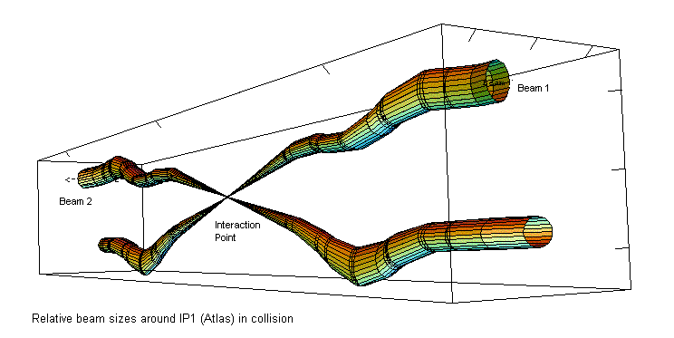
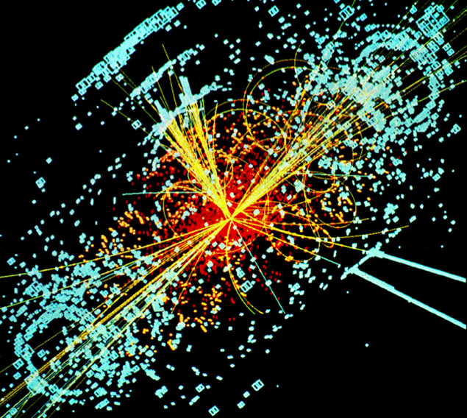
Hadron Colliders
Eric Prebys, FNAL
LHC Interaction Region
Lecture 3

Slide 2
Outline
Tevatron
pBar cooling
luminosity
LHC
parameters
“The Incident”
Maximizing luminosity (HL-LHC)
What’s next?

Slide 3
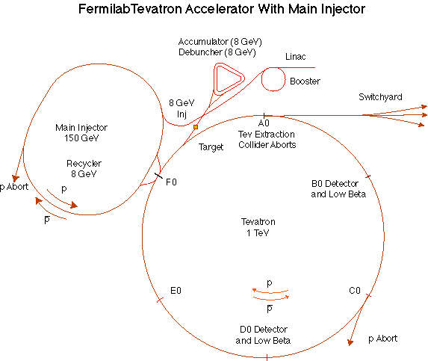
The Fermilab Accelerator Complex
MiniBooNE/BNB
NUMI

Slide 4
“Stack and Store” cycle
The Linac accelerated beam to 400 MeV, and injected it into the Booster
The Booster accelerated beam from 400 MeV to 8 GeV and transferred it to the Main Injector.
The Main Injector accelerated beam from 8 GeV to 120 GeV, and this beam was used to produce 8 GeV antiprotons.
Antiprotons were accumulated for roughly 1 day.
These were then accelerated by the Main Injector to 150 GeV, and injected into the Tevatron.
The Tevatron accelerated protons and antiprotons to 980 GeV and collided them for ~1 day.

Slide 5
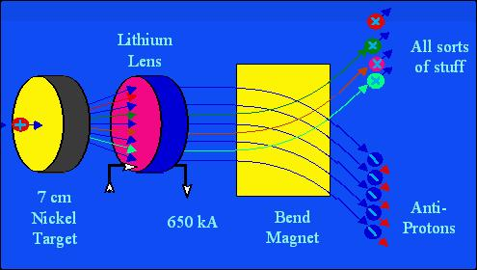
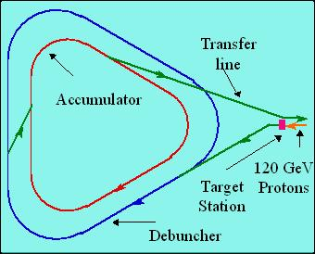
Fermilab Antiproton Source
120 GeV protons strike a target, producing many things, including antiprotons.
a Lithium lens focuses these particles (a bit)
a bend magnet selects the negative particles around 8 GeV. Everything but antiprotons decays away.
The antiproton ring consists of 2 parts
– the Debuncher – the Accumulator.

Slide 6
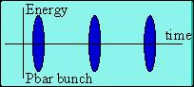
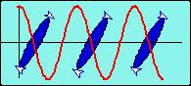
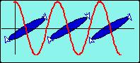
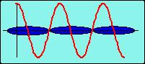
Antiproton Source – debunching
Particles enter with a narrow time spread and broad energy spread.
High (low) energy pbars take more (less) to go around…
…and the RF is phased so they are decelerated (accelerated),
resulting in a narrow energy spread and broad time spread.
At this point, the pBars are transferred to the accumulator, where they are “stacked”

Slide 7
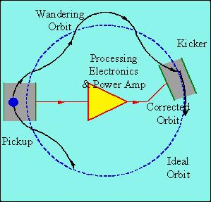
Stochastic cooling of antiprotons
Positrons will naturally “cool” (approach a small equilibrium emittance) via synchrotron radiation.
Antiprotons must rely on active cooling to be useful in colliders.
Principle: consider a single particle which is off orbit. We can detect its deviation at one point, and correct it at another:
But wait! If we apply this technique to an ensemble of particles, won’t it just act on the centroid of the distribution? Yes, but…
Stochastic cooling relies on “mixing”, the fact that particles of different momenta will slip in time and the sampled combinations will change.
Statistically, the mean displacement will be dominated by the high amplitude particles and over time the distribution will cool.

Slide 8
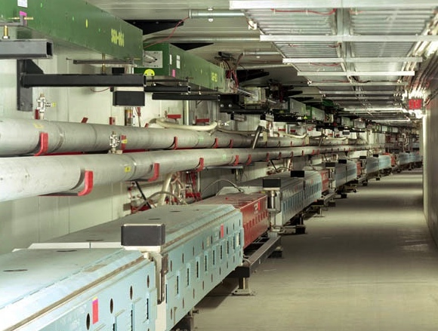
Main Injector/Recycler
The Main Injector can accept 8 GeV protons OR antiprotons from
Booster
The anti-proton accumulator
The 8 GeV Recycler (which shares the same tunnel and stores antiprotons)
It can accelerate protons to 120 GeV (in a minimum of 1.4 s) and deliver them to
The antiproton production target.
The fixed target area.
The NUMI beamline.
It can accelerate protons OR antiprotons to 150 GeV and inject them into the Tevatron.

Slide 9
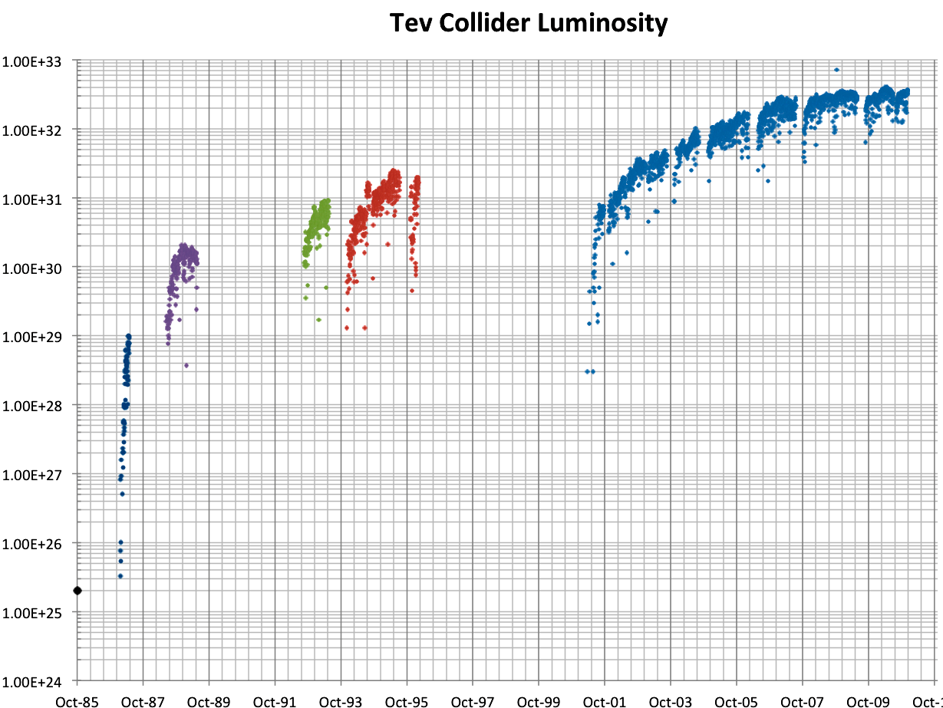
History of Fermilab Luminosity
ISR (pp) record
Original Run II Goal
SppS record
Run 1a
Run 1b
Run II
Run 0
Main Injector Construction
Discovery of top quark (1995)
87 Run

Slide 10
Proton-Proton vs. Proton-antiproton
Beyond a few hundred GeV, most interactions take place between gluons and/or virtual “sea” quarks.
No real difference between proton-antiproton and proton-proton
Because of the symmetry properties of the magnetic field, a particle going in one direction will behave exactly the same as an antiparticle going in the other direction
Can put protons and antiprotons in the same ring
This is how the SppS (CERN) and the Tevatron (Fermilab) did it.
The problem is that antiprotons are hard to make
Can get >1 positron for every electron on a production target
Can only get about 1 antiproton for every 50,000 protons on target!
It took a day to make enough antiprotons for a “store” in the Fermilab Tevatron
Ultimately, the luminosity is limited by the antiproton current.

Slide 11
Antiprotons for LHC?
At the design luminosity of the LHC, the antiproton “burn” rate would be
The is about 15 times the maximum production rate achieved by the Fermilab antiproton source
No one has a good idea how to do this
The required proton beam would be megawatts (=neutrino beam)
For this reason, it was long recognized that the next collider would be proton proton.

Slide 12
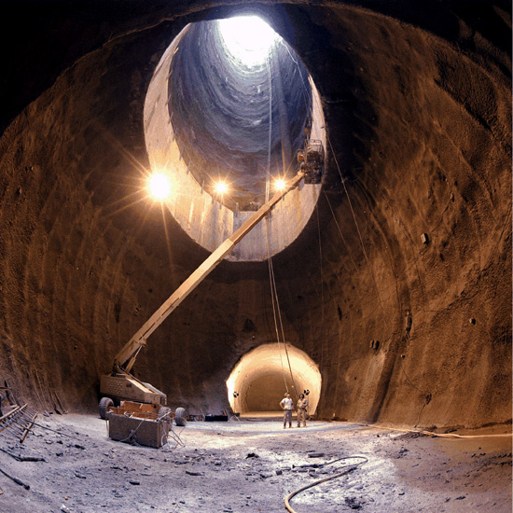
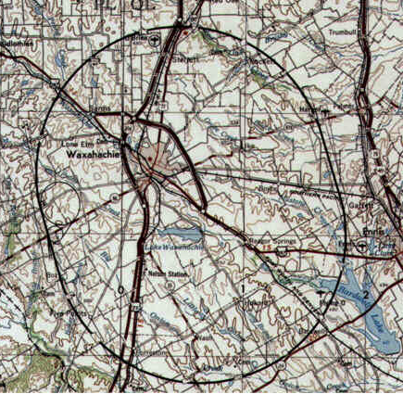
A Detour on the Road to Higher Energy
1980’s - US begins planning in earnest for a 20 TeV+20 TeV “Superconducting Super Collider” or (SSC).
87 km in circumference!
Two separate beams (like the ISR)
Considered superior to the “Large Hadron Collider” (LHC) then being proposed by CERN.
1987 – site chosen near Dallas, TX
1989 – construction begins
1993 – amidst cost overruns and the end of the Cold War, the SSC is cancelled after 17 shafts and 22.5 km of tunnel had been dug.
2001 – After the end of the LEP program at CERN, work begins on reusing the 27 km tunnel for the 7 TeV+ 7 TeV LHC

Slide 13
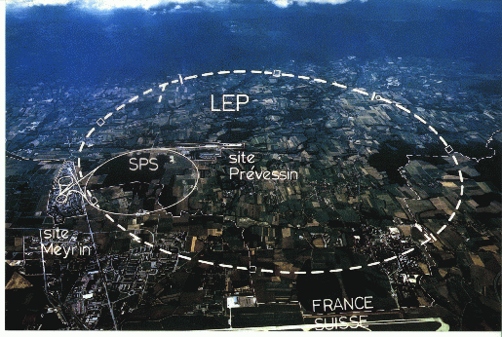
LHC: Location, Location, Location…
My House (1990-1992)
/LHC
Tunnel originally dug for LEP
Built in 1980’s as an electron positron collider
Max 100 GeV/beam, but 27 km in circumference!!

Slide 14
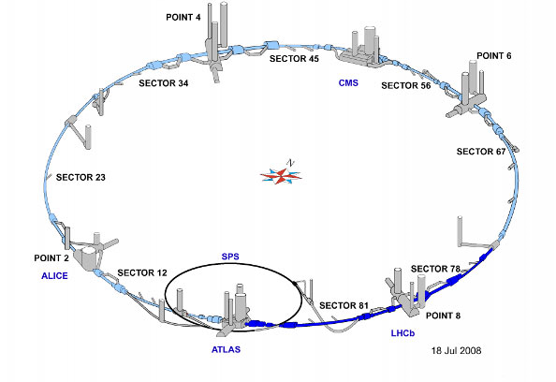
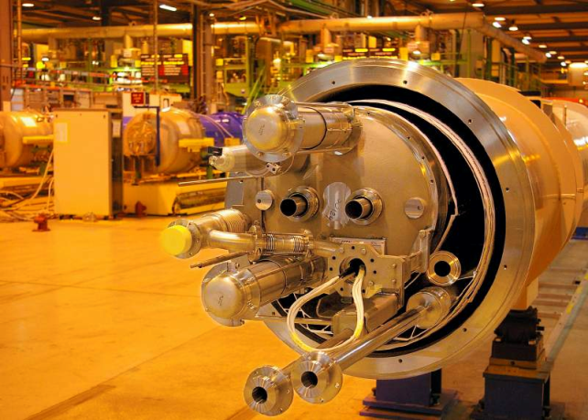
LHC Layout and Numbers
Design:
7 TeV+7 TeV proton beams
Can’t make enough antiprotons for the LHC
Magnets have two beam pipes, one going in each direction.
Stored beam energy 150 times more than Tevatron
Each beam has only 5x10⁻¹⁰ grams of protons, but has the energy of a train going 100 mph!!
These beams are focused to a size smaller than a human hair to collide with each other!
27 km in circumference
2 major collision regions: CMS and ATLAS
2 “smaller” regions: ALICE and LHCb

Slide 15
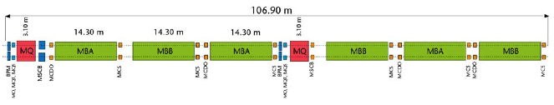
Standard LHC FODO Cell
e⁺e⁻ or proton-antiproton (opposite charge) colliders had particles going in opposite directions in the same beam pipe
Because the LHC collides protons (same charge), the magnets have two apertures with opposite fields
quadrupoles
dipoles (B_{max} = 8.3 T)

Slide 16
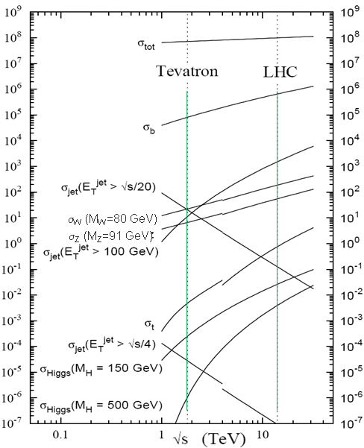
Nominal LHC Parameters Compared to Tevatron
Parameter | Tevatron | “nominal” LHC
Circumference | 6.28 km (2*PI) | 27 km
Beam Energy | 980 GeV | 7 TeV
Number of bunches | 36 | 2808
Protons/bunch | 275x10⁹ | 115x10⁹
pBar/bunch | 80x10⁹ | -
Stored beam energy | 1.6 + .5 MJ | 366+366 MJ*
Magnet stored energy | 400 MJ | 10 GJ
Peak luminosity | 3.3x10³² cm⁻²s⁻¹ | 1.0x10³⁴ cm⁻²s⁻¹
Main Dipoles | 780 | 1232
Bend Field | 4.2 T | 8.3 T
Main Quadrupoles | ~200 | ~600
Operating temperature | 4.2 K (liquid He) | 1.9K (superfluid He)
Increase in cross section of up to 5 orders of magnitude for some physics processes
*Each beam = TVG@150 km/hr ➔ very scary numbers
1.0x10³⁴ cm⁻²s⁻¹ ~ 50 fb⁻¹/yr= ~5 x total TeV data

Slide 17
Protecting the Machine: Multi-stage Collimation

Slide 18
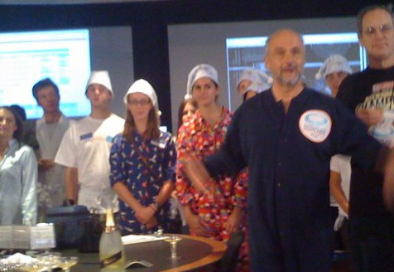
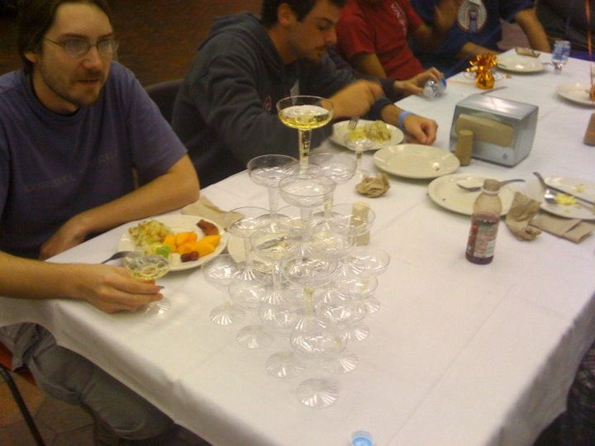
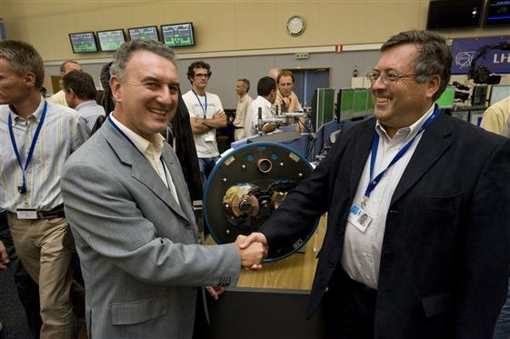
Sept 10, 2008: The (first) big day
9:35 – First beam injected
9:58 – beam past CMS to point 6 dump
10:15 – beam to point 1 (ATLAS)
10:26 – First turn!
…and there was much rejoicing
Commissioning proceeded smoothly and rapidly until September 19th, when something very bad happened

Slide 19

Nature abhors a (news) vacuum…
Italian newspapers were very poetic (at least as translated by “Babel Fish”):
"the black cloud of the bitterness still has not been dissolved on the small forest in which they are dipped the candid buildings of the CERN"
“Lyn Evans, head of the plan, support that it was better to wait for before igniting the machine and making the verifications of the parts.“*
Or you could Google “What really happened at CERN”:
**
* “Big Bang, il test bloccato fino all primavera 2009”, Corriere dela Sera, Sept. 24, 2008
**http://www.rense.com/general83/IncidentatCERN.pdf

Slide 20
What (really) really happened on September 19^{th*}
Sector 3-4 was being ramped to 9.3 kA, the equivalent of 5.5 TeV
All other sectors had already been ramped to this level
Sector 3-4 had previously only been ramped to 7 kA (4.1 TeV)
At 11:18AM, a quench developed in the splice between dipole C24 and quadrupole Q24
Not initially detected by quench protection circuit
Power supply tripped at .46 sec
Discharge switches activated at .86 sec
Within the first second, an arc formed at the site of the quench
The heat of the arc caused Helium to boil.
The pressure rose beyond .13 MPa and ruptured into the insulation vacuum.
Vacuum also degraded in the beam pipe
The pressure at the vacuum barrier reached ~10 bar (design value 1.5 bar). The force was transferred to the magnet stands, which broke.
*Official talk by Philippe LeBrun, Chamonix, Jan. 2009

Slide 21
Pressure forces on SSS vacuum barrier
Vacuum
Pressure
10 bar
1/3 load on cold mass (and support post)
~23 kN
1/3 load on barrier
~46 kN
Total load on 1 jack ~70 kN
V. Parma

Slide 22
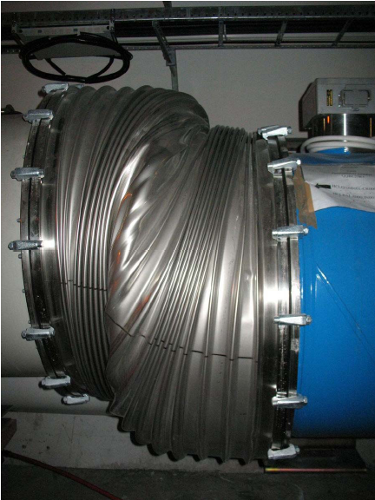
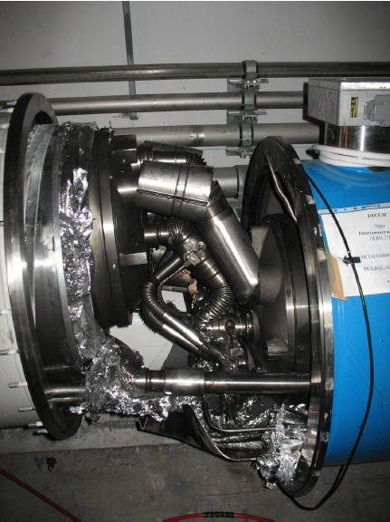
Collateral damage: magnet displacements
QQBI.27R3

Slide 23
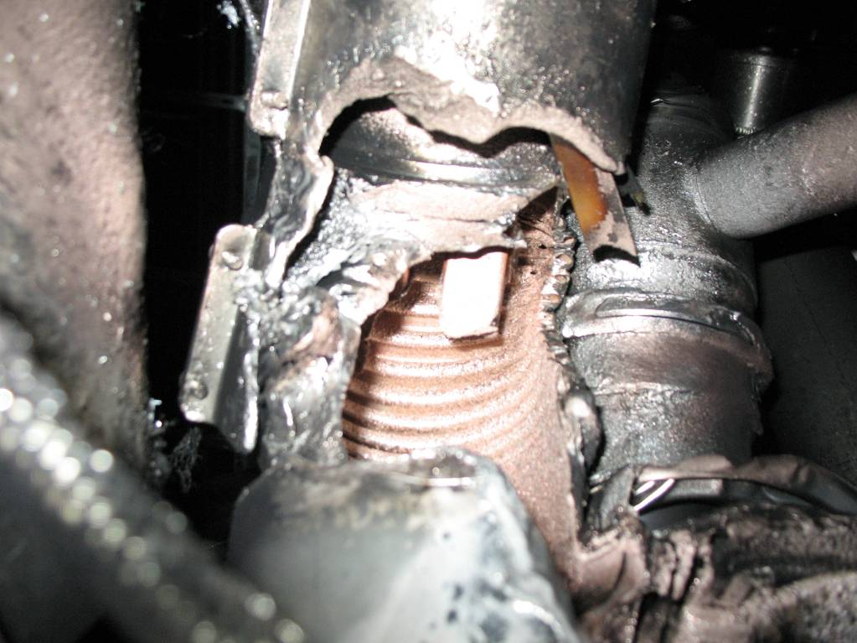
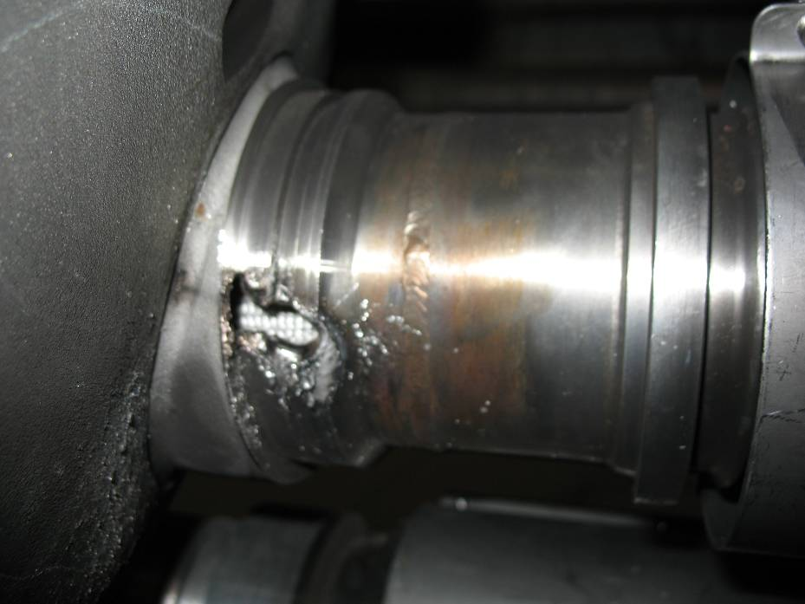
Collateral damage: secondary arcs
QBBI.B31R3 M3 line
QQBI.27R3 M3 line

Slide 24
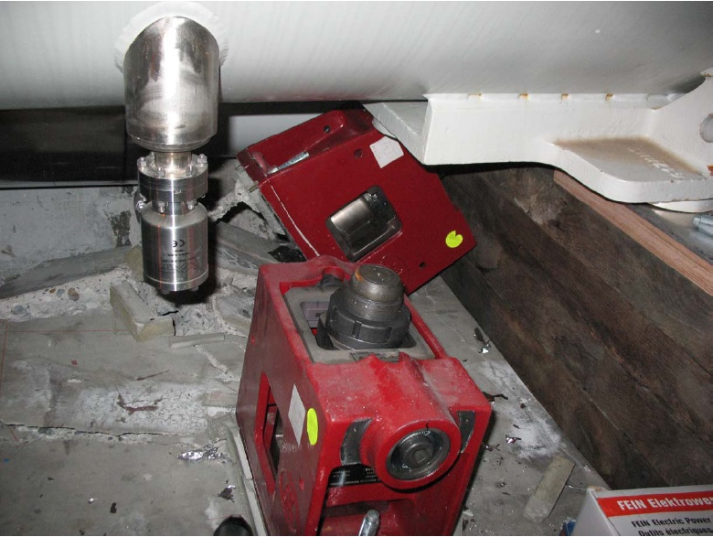
Collateral damage: ground supports

Slide 25
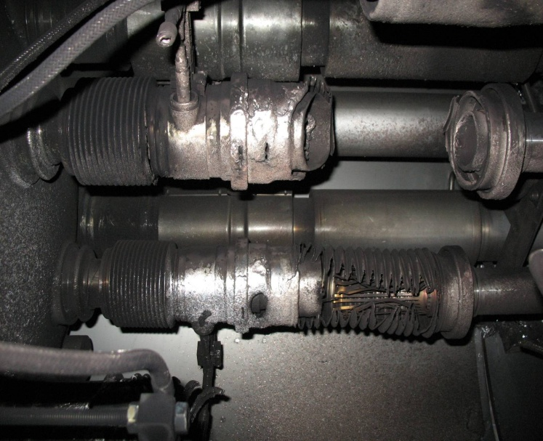
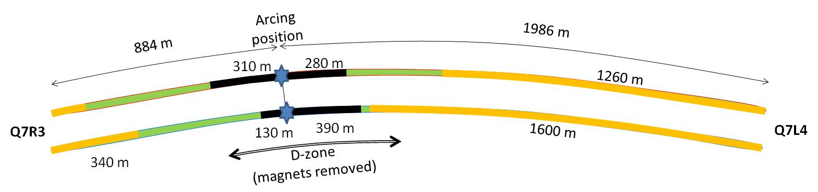

Collateral damage: Beam Vacuum
Arc burned through beam vacuum pipe
clean
MLI
soot
The beam pipes were polluted with thousands of pieces of MLI and soot, from one extremity to the other of the sector
LSS3
LSS4
OK
Debris
MLI
Soot

Slide 26
Important questions about Sept. 19
Why did the joint fail?
Inherent problems with joint design
No clamps
Details of joint design
Solder used
Quality control problems
Why wasn’t it detected in time?
There was indirect (calorimetric) evidence of an ohmic heat loss, but these data were not routinely monitored
The bus quench protection circuit had a threshold of 1V, a factor of >1000 too high to detect the quench in time.
Why did it do so much damage?
The pressure relief system was designed around an MCI Helium release of 2 kg/s, a factor of ten below what occurred.

Slide 27
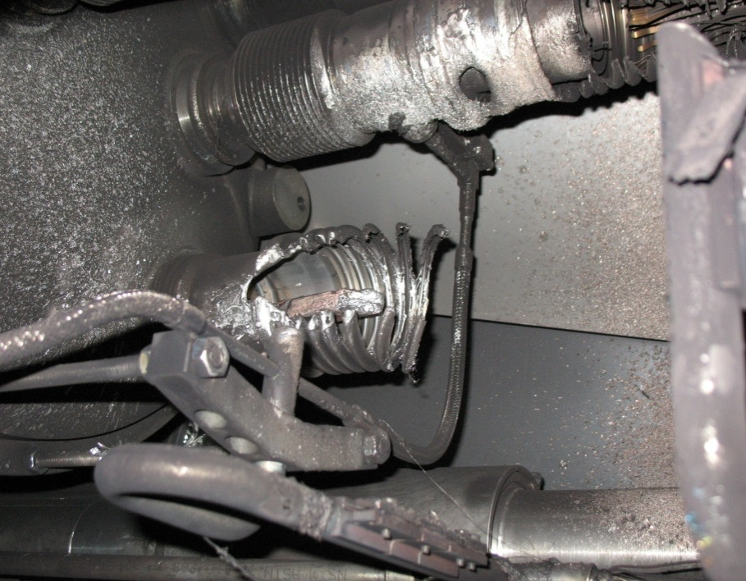
What happened?
Working theory: A resistive joint of about 220 nΩ with bad electrical and thermal contacts with the stabilizer
No electrical contact between wedge and U-profile with the bus on at least 1 side of the joint
No bonding at joint with the U-profile and the wedge
Loss of clamping pressure on the joint, and between joint and stabilizer
Degradation of transverse contact between superconducting cable and stabilizer
Interruption of longitudinal electrical continuity in stabilizer
Problem: this is where the evidence used to be
A. Verweij

Slide 28
Interim Improvements (2008-2009)
Bad joints
Test for high resistance and look for signatures of heat loss in joints
Warm up to repair any with signs of problems (additional three sectors)
Quench protection
Old system sensitive to 1V
New system sensitive to .3 mV
Pressure relief
Warm sectors (4 out of 8)
Install 200mm relief flanges
Enough capacity to handle even the maximum credible incident (MCI)
Cold sectors
Reconfigure service flanges as relief flanges
Reinforce floor mounts
Enough capacity to handle the incident that occurred, but not quite the MCI

Slide 29
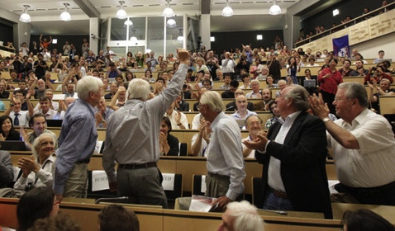
After the first shutdown
2009
November 20th: Particles circulate again
Based on a detailed thermal model of the joints and failure scenarios, it’s decided to limit energy to 3.5 TeV
2010
March 30th: 3.5 + 3.5 TeV collisions
Energy limited by flaw which caused accident
2012
January (Chamonix meeting): based on observed performance and revised modeling, it’s decided to increase energy to 4 TeV.
April 5th: Energy increased to 4 + 4 TeV
July 4th: Announced the discovery of the Higgs
2013
Feb. 14th: Start 2 year shutdown to address design flaw and allow full energy operation
ALL (~10000) joints resoldered, clamped and radiographed.
Remaining sectors outfitted with improved pressure relief.

Slide 30
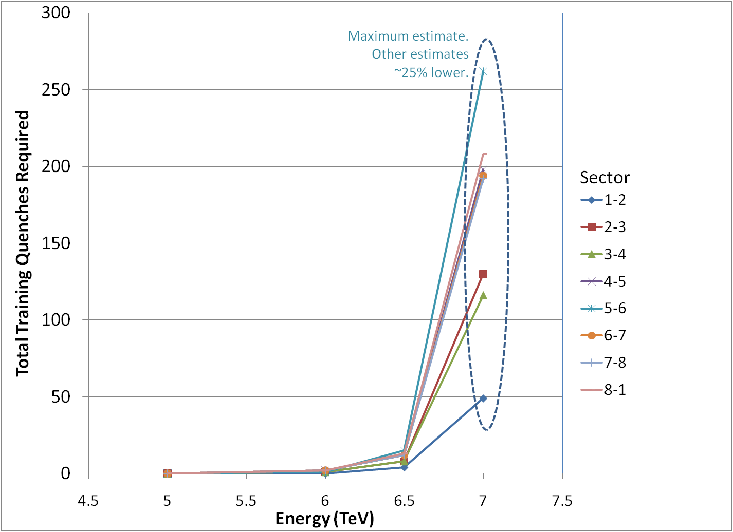
Energy after LS1?*
Recall: “lost training” problem before “incident”
Note, at high field, max 2-3 quenches/day/sector
Sectors can be done in parallel/day/sector (can be done in parallel)
Ultimate energy somewhere between 6.5 and 7 TeV/beam
*my summary of data from A. Verveij, talk at Chamonix, Jan. 2009

Slide 31
After the shutdown
After repairs are completed, accelerator will come back up in 2015 at something close to the design energy
At least 6.5 TeV/beam
The LHC will be the centerpiece of the world’s energy frontier physics program for at least the next 15-20 years.

Slide 32
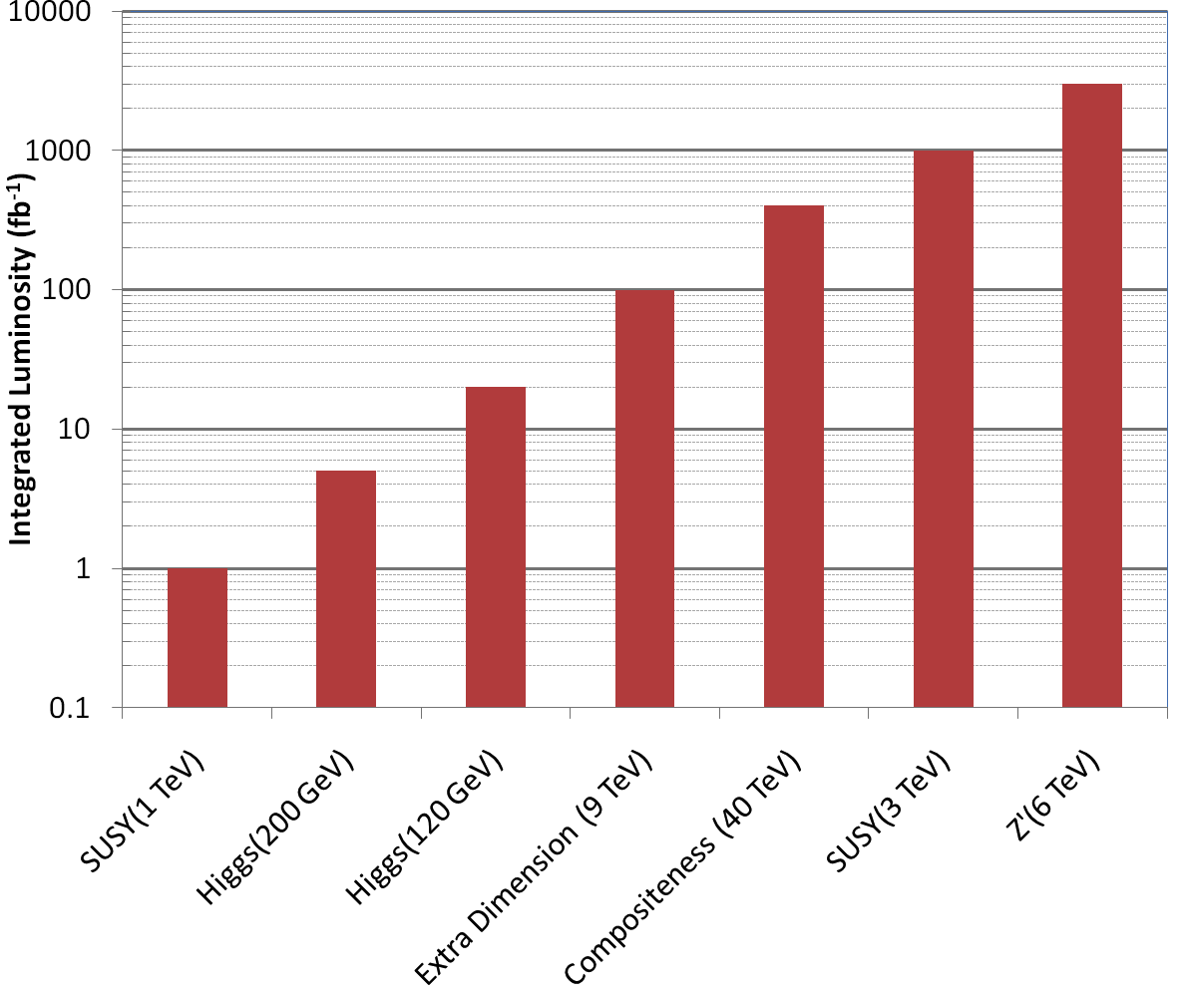
Longer Term: The Big Picture
3000 fb⁻¹
~ 50 years at nominal LHC luminosity!
The future begins now
How can we increase the luminosity??

Slide 33
Limits to LHC Luminosity*
Brightness, limited by
PSB injection energy
PS
Max tune-shift
Total beam current, limited by machine protection(!), e-cloud and other instabilities
β*, limited by
magnet technology
chromatic effects
Geometric factor, related to crossing angle…
*see, eg, F. Zimmermann, “CERN Upgrade Plans”, EPS-HEP 09, Krakow, for a thorough discussion of luminosity factors.

Slide 34
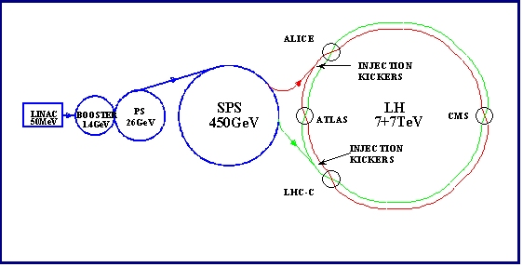
Current LHC Acceleration Sequence and Brightness Issues
Space Charge Limitations at Booster and PS injection
Transition crossing in PS and SPS
Schematic ONLY. Scale and orientation not correct

Slide 35
Addressing brightness issues
There are plans to address two of the major sources of emittance blowup in the injector chain
Injection from the LINAC into the PS Booster
The current linac uses proton painting at 50 MeV
New LINAC4 will use ion injection at 160 MeV
Space charge at injection into PS
Extraction energy of the PS Booster will be increased from 1.4 to 2.0 GeV
These upgrades are scheduled to take place during Long Shutdown 2

Slide 36
Limits to β*
β
β distortion of off-momentum particles (affects collimation)
s
➔ small β* means large β (aperture) at focusing triplet

Slide 37
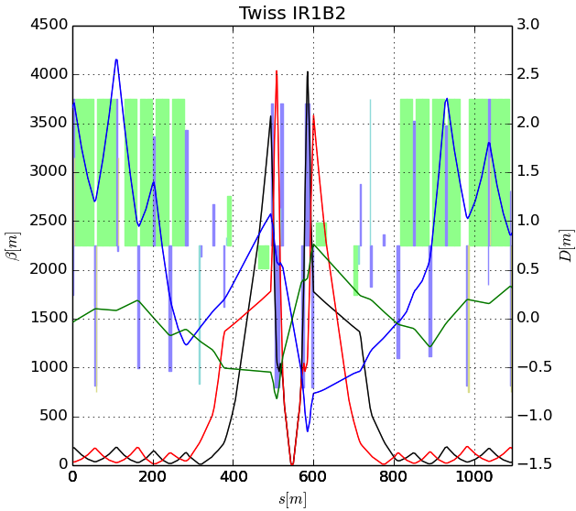
The Case for New Quadupoles
HL-LHC Proposal: β*=55 cm ➔ β*=10 cm
Just like classical optics
Small, intense focus ➔big, powerful lens
Small β*➔huge β at focusing quad
Need bigger quads to go to smaller β*
Existing quads
70 mm aperture
200 T/m gradient
Proposed for upgrade
140 mm aperture
200 T/m gradient
Field 70% higher at pole face
➔ Beyond the limit of NbTi

Slide 38
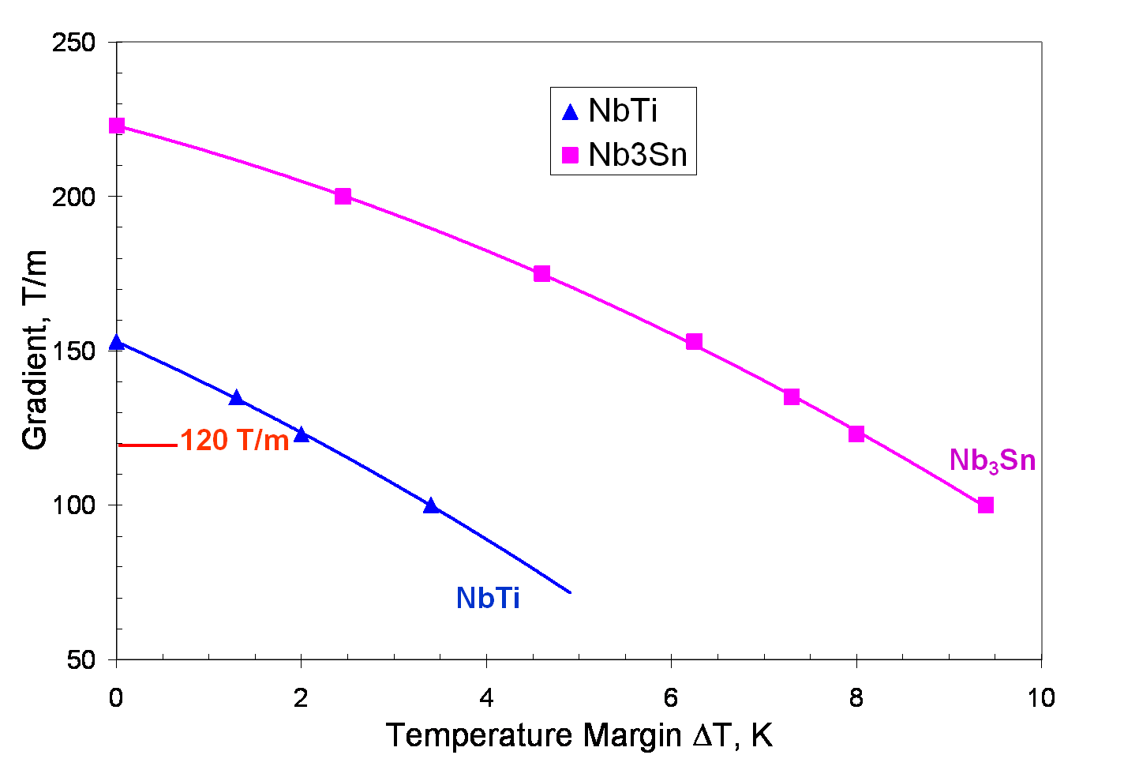
Motivation for Nb₃Sn
Nb₃Sn can be used to increase aperture/gradient and/or increase heat load margin, relative to NbTi
Limit of NbTi magnets
Very attractive, but no one has ever built accelerator quality magnets out of Nb₃Sn
Whereas NbTi remains pliable in its superconducting state, Nb3Sn must be reacted at high temperature, causing it to become brittle
Must wind coil on a mandril
React
Carefully transfer to yolk
120 mm aperture

Slide 39
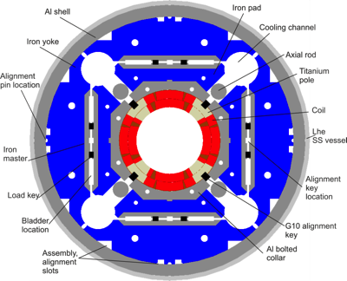
US-LARP Magnet Development Tree
LHC Prototype 4 m long
150 mm bore
Being designed jointly with CERN

Slide 40
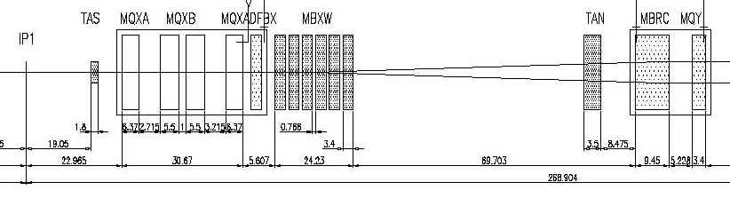
IR Layout: the need for a crossing angle
Separation Dipole
Final Triplet
IP
~59 m
Nominal Bunch spacing: 7.5 m
Collision spacing: 3.75 m
~2x15 parasitic collisions per IR
Remember: ALL of these would cause equal tune shifts
Need Crossing Angle

Slide 41
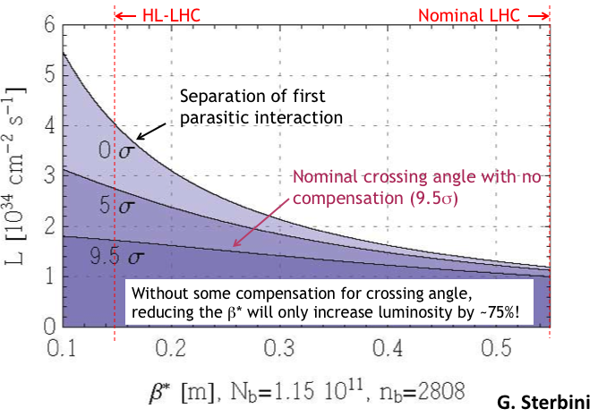
Crossing Angle Considerations
“Piwinski Angle”
Crossing angle reduces luminosity
Minor effect at current β*, but largely cancels benefit of lowering β*

Slide 42
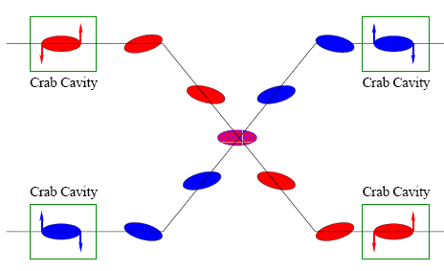
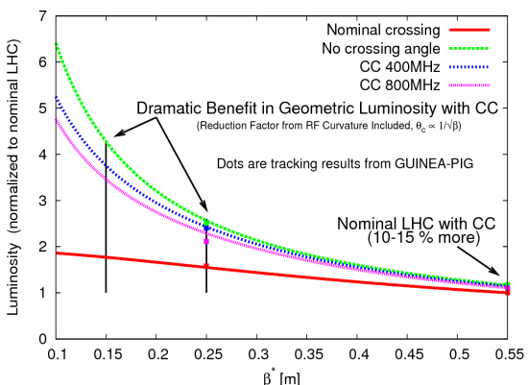
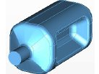
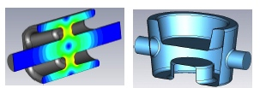
Baseline Approach: Crab Cavities
Technical Challenges
Crab cavities have only barely been shown to work.
Never in hadron machines
LHC bunch length ➔ low frequency (400 MHz)
19.2 cm beam separation ➔ “compact” (exotic) design
Additional benefit
Crab cavities may help level luminosity!

Slide 43
Luminosity Leveling
Original goal of luminosity upgrade: >10³⁵ cm⁻²s⁻¹
Leads to unacceptable pileup in detectors
New goal: 5x10³⁴ leveled luminosity
Options
Crab cavities
β* modifications
Lateral separation
“Crab kissing” – sort of complicated

Slide 44
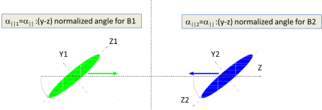
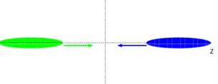
Crab Kissing*
*S. Fartoukh

Slide 45
Long Term Plan*
*L. Rossi, LARP/HL-LHC Meeting, Nov. 2013

Slide 46
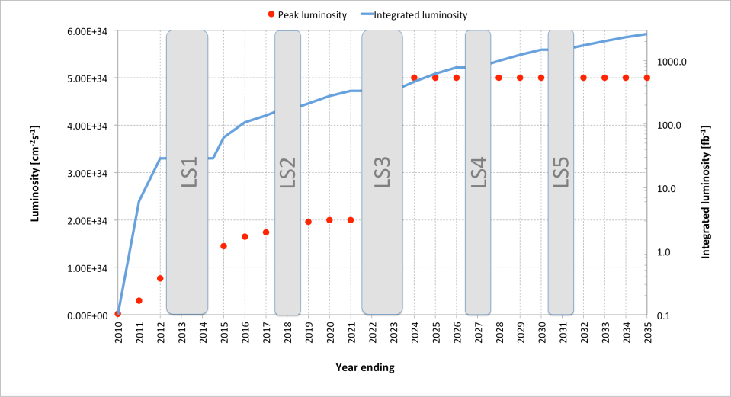
The Long Game
HL-LHC Upgrades

Slide 47
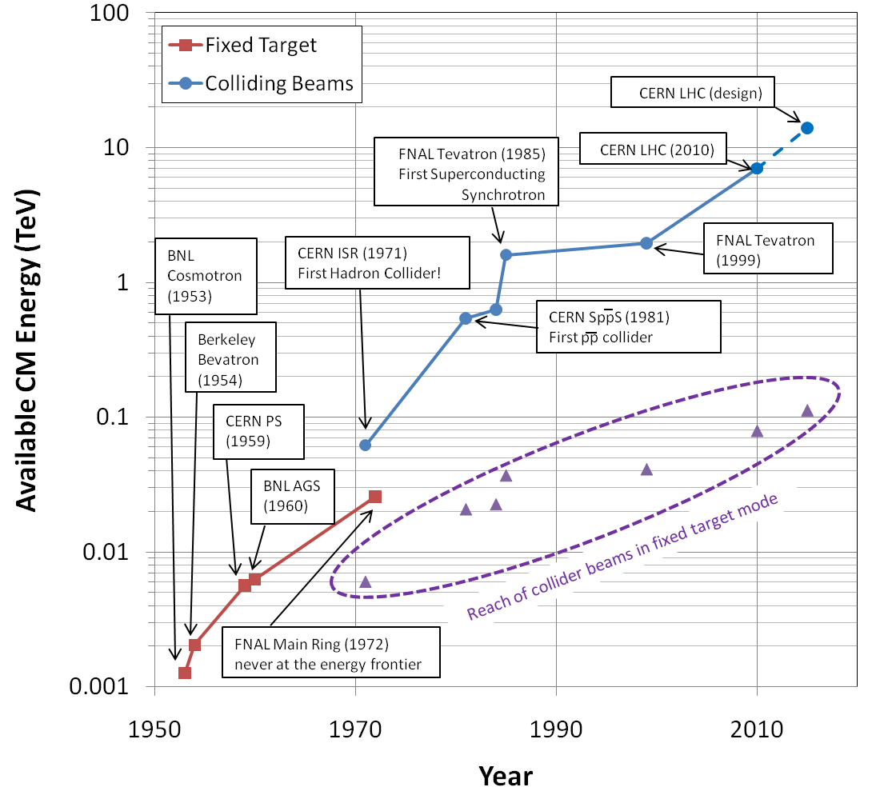
Summary: Evolution of the Energy Frontier
~a factor of 10 every 15 years
This will not continue

Slide 48
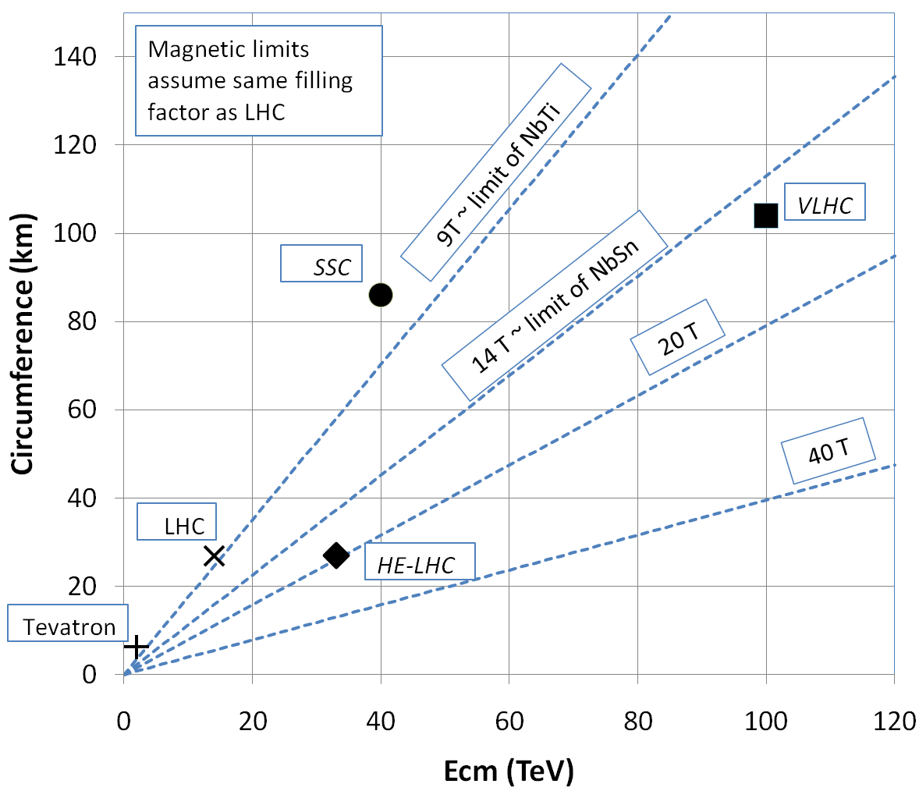
What next?
The energy of Hadron colliders is limited by feasible size and magnet technology. Options:
Get very large (~100 km circumference)
More powerful magnets (requires new technology)
All accelerator magnets based on this
Future magnets could be based on this

Slide 49
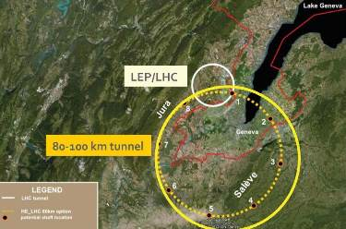
Future Circular Collider (FCC)
Currently being discussed for ~2030s
80-100 km in circumference
Niobium-3-Tin (Nb₃Sn) magnets.
~100 TeV center of mass energy

Slide 50
Some things to think about for FCC
Recall that luminosity is given by
If we wanted to keep just 10³⁴ luminosity (probably not enough), the γ factor would let us back down on N_{b} a bit, but to keep the crossing rate the number of bunches would increase with the circumference so stored energy would be
What are the options to make it more compact, and or go to even higher energies?
~1 ton on TNT = Scary!

Slide 51
Superconductor Options
Traditional
NbTi
Basis of ALL superconducting accelerator magnets to date
Largest practical field ~8T
Nb₃Sn
Advanced R&D
Being developed for large aperture/high gradient quadrupoles
Larges practical field ~14T
High Temperature
Industry is interested in operating HTS at moderate fields at LN₂ temperatures. We’re interested in operating them at high fields at LHe temperatures.
MnB₂
promising for power transmission
can’t support magnetic field.
YBCO
very high field at LHe
no cable (only tape)
BSCCO (2212)
strands demonstrated
unmeasureably high field at LHe
Focusing on this, but very expensive
➔ pursue hybrid design

Slide 52
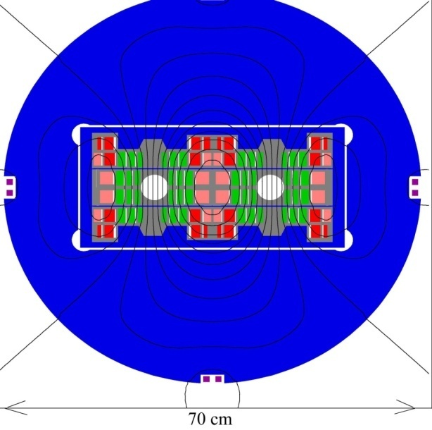

Potential Designs
P. McIntyre 2005 – 24T ss Tripler, a lot of Bi-2212 , Je = 800 A/mm2
E. Todesco 2010
20 T, 80% ss
30% NbTi
55 %NbSn
15 %HTS
All Je < 400 A/mm2

Slide 53
Things I didn’t talk about
Ion colliders
Challenges: accelerating different species of ions.
Pb-p challenge: RF sets period, but slightly different momentum = slightly different orbit.
e-p colliders
Challenges:
efficient high intensity electron beams
interaction regions

Slide 54

Opportunity: LARP Toohig Fellowship
Named for Tim Toohig, one of the founders of Fermilab
Open to recent PhD’s in accelerator science or HEP.
Successful candidates divide their time between CERN and one of the four host labs.
Past
Helene Felice, LBNL, now staff
Rama Calaga, BNL, now CERN staff
Ricdardo de Maria, BNL, now CERN Fellow
Themis Mastoridis, SLAC, now CERN Fellow
Ryoichi Miyamoto, BNL, now ESS Staff
Dariusz Bocian, FNAL, now Ass. Prof. at The Henryk Niewodniczański Institute of Nuclear Physics
Valentina Previtali, FNAL, now teaching in Switzerland
Present
Simon White, BNL
John Cesaratto, SLAC
Ian Pong, LBNL
Silvia Verdu Andres, BNL

Slide 55
Further Reading
Edwards and Syphers “An Introduction to the Physics of High Energy Accelerators”
My personal favorite
Concise. Scope and level just right to get a solid grasp of the topic
Crazy expensive, for some reason.
Helmut Wiedemann, “Particle Accelerator Physics”
Probably the most complete and thorough book around (originally two volumes)
Well written
Scope and mathematical level very high
Edmund Wilson, “Particle Accelerators”
Concise reference on a number of major topics
Available in paperback (important if you are paying)
A bit light
Klaus Wille “The Physics of Particle Accelerators”
Same comments
Fermilab “Accelerator Concepts” (“Rookie Book”)
http://www-bdnew.fnal.gov/operations/rookie_books/Concepts_v3.6.pdf
Particularly chapters II-IV
USPAS course: http://uspas.fnal.gov/

